Slide 1

Presentation for School Bus Solution
July 2019

Slide 2




About SPL - Company vision is to be the best retail IT service provider
SPL Information Technology is an IT service provider established by SPL HK in mainland China in 2005.
Focus on & Retail App & infrastructure services
With 400+ professionals
Serves 30+ retail customers
Operates 70+ service stations in tier 1,2,3 & 4 cities in China and some countries/regions in APAC
- Confidential -

Slide 3



















Company development - Wider coverage, increasing clients and diverse business range
New coverage
App Development
Help Desk
Dispatch
ITO
Project Rollout
Store Network
Data Center
NOC
Private & Hybrid clouds
New client
New business
- Confidential -

Slide 4
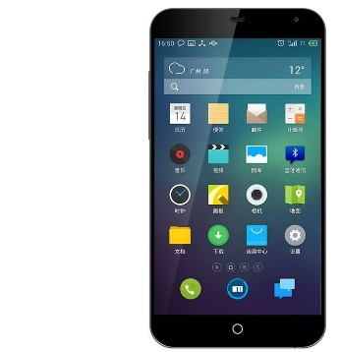



Solution introduction - Architecture
App installed on parent's mobile phone
App installed on shuttle staff’
s mobile phone
Management console in the school
Backend system and database on the cloud
- Confidential -

Slide 5
Solution introduction - Function module for parent
Other function
Complains submission
Survey
Attendance
Arrival
Sign-off(QRCode)
Arrival notification
Registration(parent, child, family)
Application for absence
New pick-up site application
Departure
Journey
Real-time position of shuttle bus
Estimated arrival time for pick-up
Emergency broadcast
Onboard Sign-on(QR Code)
Departure notification
- Confidential -

Slide 6
Solution introduction - Function module for school & shuttle bus staff
1
Roll call by staff's app with parent/surrogate's QRCode
Vehicle management, i.e. condition, maintenance information, etc.
2
3
Driver management, i.e. license, personal information, etc.
Interface with government platform, i.e. route design, application, optimization, etc.
4
- Confidential -

Slide 7
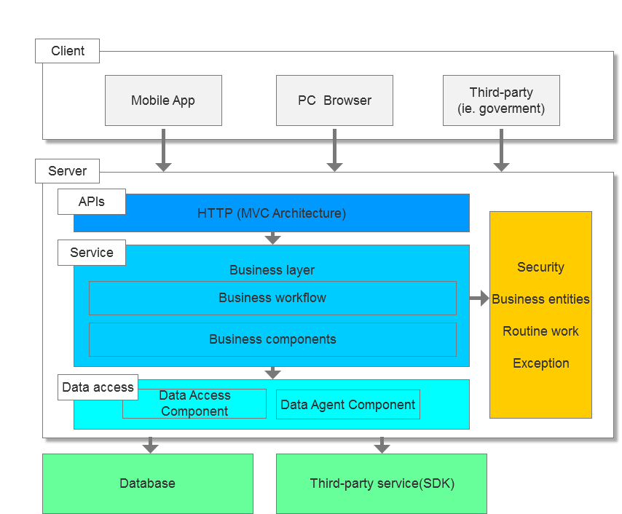
System introduction - System architecture for the platform
- Confidential -

Slide 8
Function introduction（1） - Parent's Client
Home page: child state, bus live location, application for absence, parent's QRCode, praise/ complaint/suggestion, survey.
Messages: absence, sign-on, arrive school, leave school, arrive station, school notification, other system platform notification.
Personal Center: children info, family info, station info, setting( logout, security code, password, platform suggestion)
Regestion: name, mobile, face photo, agreement.
Login: mobile number, verification code/pwd.
- Confidential -

Slide 9
Function introduction（2） - Shuttle staff's Client
Home page: one-click alarm, bus failure, roll call, parent's suggestion box.
Bus: daily check, maintain record.
Message: absence application, school notification, platform notification.
Personal Center：my route, setting
Login: mobile number, verification code/pwd.

Slide 10
Function introduction（3） - School management's Client
Route & station management: route name, station name, station location(GPS), timetable, bus, driver, shuttle staff.
Shuttle staff management: name, phone, route in charge, account and password.
Schoolchild management: name, id, parent, family, address, sign-on route&station.
Driver and bus management：driver's name, id, driving license, bus, car number, failture record, maintain record, repair record.
Parent's messages: message list, message detail.
Notification management: send notice to parent/staff with group or P2P.

Slide 11
Function introduction（4） - Bus service conpany's Client
Bus management: school in charge, car number, bus basic info, yearly inspection record, change route's bus.
Driver management: school in charge, name, id, driving license, school bus driving license, change route's drive.

Slide 12
Function introduction（5） - System platform's Client
Route deviation alarm.
Bus service company: company info, account and password, emergency contact, buses in charge, drivers in charge.
School：school info, address, its bus service supplier, send notification to school.
Family administrator's appeal: retriete security code.
Application user's suggection: content and photo.
Bus state: bus current location, speed.
Family info: administrator, member, child.
Other data management: ie. bus's daily check list.

Slide 13
Charge model & SLA - Software as A Service
No one time cost i.e. hardware, license, development and the ongoing expenses.
Service fee will be charged based on the schoolchild that has bus service every semeter.
Service Level Agreement will be defined together with school.
- Confidential -

Slide 14

Thank you!
SPL Information Technology

